Slide 1
Concurrency Control
chapter 13: “Concurrency Control” (Petkovic)
ACID Property: https://en.wikipedia.org/wiki/ACID_(computer_science)
Concurrency control https://en.wikipedia.org/wiki/Concurrency_control

Slide 2
Agenda
Transactions
Concurrency controls methods
ACID properties
Isolation levels
Locking vs multi-versioning

Slide 3
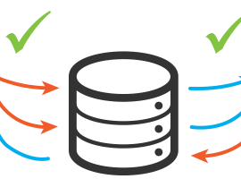
Concurrency Controls
Ensures that database transactions are performed concurrently without violating the data integrity of the databases
Essential element for correctness in any system where two database transactions or more, executed with time overlap, can access the same data.

Slide 4
Transactions
Transaction = A discrete unit of work that must be completely processed or not processed at all
  May involve multiple updates
  If any update fails, then all other updates must be cancelled
packages together read and write operations so that the database system can guarantee the consistency of data
Transaction Types:
  Implicit -> Specifies any single INSERT, UPDATE, or DELETE statement as a transaction unit
  Explicit ->marked using statements such as BEGIN TRANSACTION, COMMIT, and ROLLBACK

Slide 5
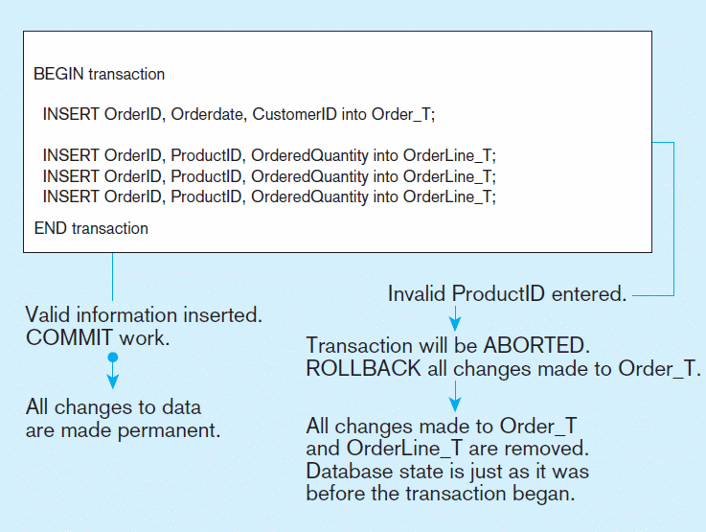
Figure 7-10 An SQL Transaction sequence (in pseudocode)

Slide 6
SQL Server syntax
--Applies to SQL Server and Azure SQL Database
BEGIN { TRAN | TRANSACTION }
[ { transaction_name | @tran_name_variable }
[ WITH MARK [ 'description' ] ]
]
[ ; ]

Slide 7
Try it!!!! Transaction Example
BEGIN transaction t1
INSERT INTO department values ('D6' , 'Marketing', 'San Francisco' )
INSERT INTO department values ('D7' , 'Customer Serv', 'Chicago' )
SELECT * FROM department ORDER BY dept_no
ROLLBACK;
SELECT *
FROM department

Slide 8
Why is concurrency control needed
Shared data across apps and users
Multiple changes at the same time
Data access at the same time needs to be correct and consistent
Notes:
Data in the database is shared between many users and application programs
Many users can make modifications to the database at the same time, executed with time overlap
Data access at the same time needs to be correct and consistent

Slide 9
Problem 1
You are an online retailer who sells textbooks to students & schools. You have a database that keeps track of how many of each textbook is available on stock to sell. If you sell 1 book, the amount of available books decreases by 1. If you add 5 books to the inventory, the amount increases by 5 and so on. If an order of 1 book gets cancelled, the inventory is updated with 1 more book.
You have a situation where an existing order gets cancelled, and another student purchases the same book at exact the same time.
What is the total value of your inventory after those two transactions are completed?
BookID | Title | AvailableOnStock
1000 | Modern Database Management | 10

Slide 10
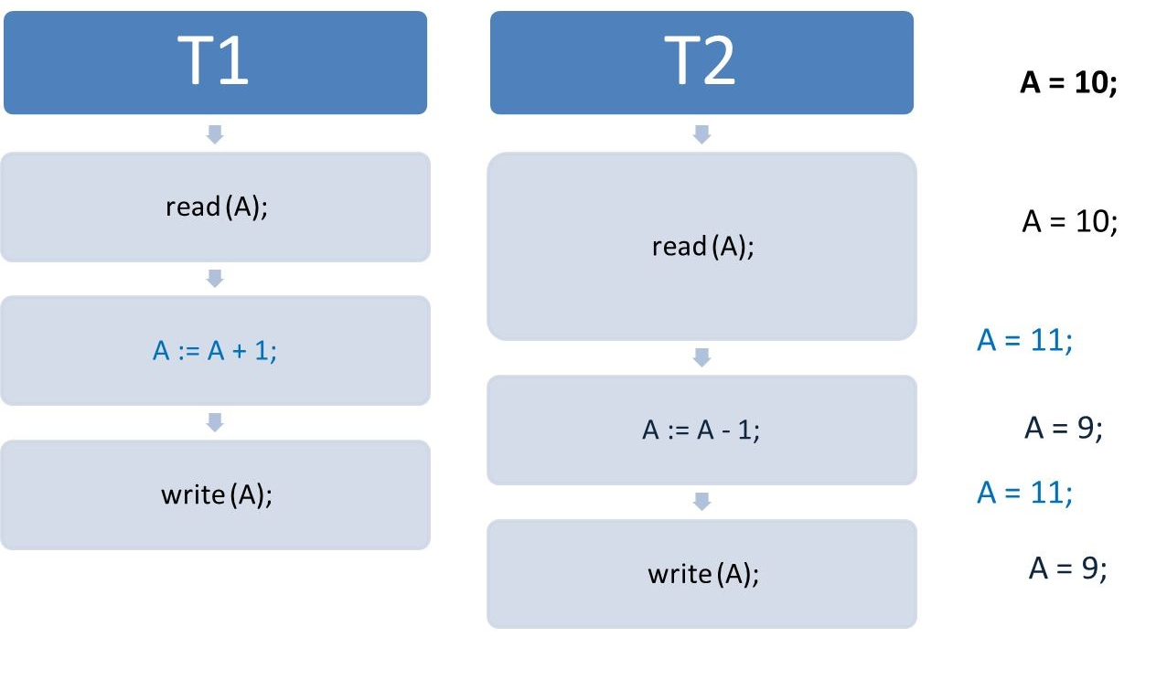
Cancelling order
Buying 1 book

Slide 11
Cancelling
an order
Buying a book
Notes:
example, one customer is

Slide 12
Cancelling an order
Buying a book

Slide 13
Cancelling an order
Buying a book

Slide 14
Cancelling order
Buying a book

Slide 15
Cancelling order
Buying a book

Slide 16
Lost Update Problem
Cancelling order
Buying a book
LOST UPDATE – because the update command from T1 is lost.
The result should be:
A= 10 -> starting point
A+ 1 =11 cancelling order
A-1 = 10 buying a book
So, Final A = 10

Slide 17
Problem 2
The Inventory Manager ordered 10 copies of “Modern DB Management” from the book manufacturer to increase the inventory. After the books arrived at the warehouse, she begin to update the inventory system. Before she clicked “confirm”, she realized she had ordered the wrong book, therefore she rolled back/undo her changes.
At the very same time, an administrator at a private college purchased all available “Modern DB Management” books. How many books did the administrator buy?
BookID | Title | AvailableOnStock
1000 | Modern DB Management | 10

Slide 18
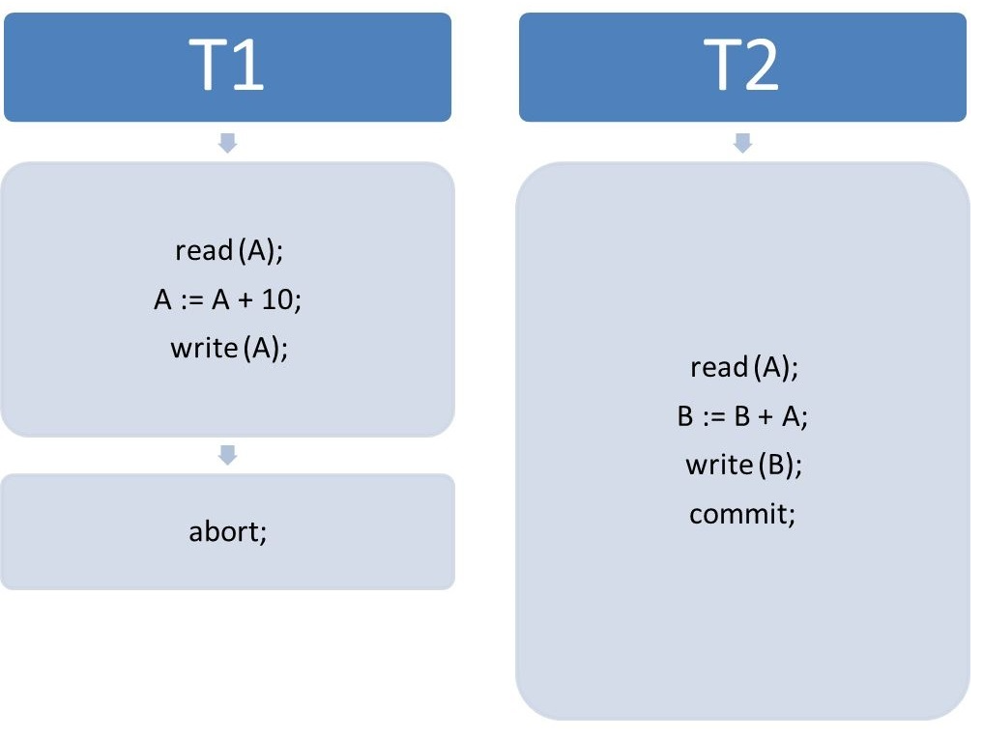
Inventory Manager
Purchasing books
A = 10
A: = ?
A: = ?

Slide 19

Dirty read problem
Inventory Manager
Adding books
A = 10
Problem: Customers bought more books than what’s available on stock due to dirty reads
A: = 20
A: = 20
A:=A
Write( -A);
Commit;

Slide 20
Uncontrolled Concurrency Problems
  The lost update problem
  The dirty read problem
  The incorrect summary problem
  Nonrepeatable reads
  Phantoms records
Notes:
The lost update concurrency problem occurs when no isolation is provided to a transaction from other transactions. This means that several transactions can read the same data and modify it. The changes to the data by all transactions, except those by the last transaction, are lost.
Dirty reads - reading process can see data that doesn’t exist because the transaction was never committed.
The nonrepeatable read concurrency problem occurs when one process reads data several times, and another process changes the same data
between two read operations of the first process. Therefore, the values read by both read operations of the first process are different.
The phantom concurrency problem is similar to the nonrepeatable read concurrency problem, because two subsequent read operations can display different values, but in this case, the reason for this behavior lies in the different number of rows being read the first time and the second time. (Additional rows, called phantoms, are inserted by other transactions.)

Slide 21
Properties of Transactions
set of properties of database transactions intended to guarantee validity even in the even in the event of errors
ACID Properties:
  Atomicity
  Consistency
  Isolation
  Durability
Notes:
The goal of ACID properties to guarantee the data integrity and validity when failures occurs.
What kind of failures: power outages, network outages, errors resulting from a dived by zero operation.
The ACID property is satisfied by what is called a TRANSACTION –single logical operation of the data.

Slide 22
Atomicity
Each transition is a single "unit", which either succeeds completely, or fails completely
An atomic system must guarantee atomicity in each situation, including power failures, errors and crashes.
Notes:
Atomicity guarantees that each transaction is treated as a single "unit", which either succeeds completely, or fails completely
if any of the statements constituting a transaction fails to complete, the entire transaction fails, and the database is left unchanged.
An atomic system must guarantee atomicity in each and every situation, including power failures, errors and crashes.

Slide 23
Consistency
any data written to the database must be valid according to all defined rules, including constraints, cascades, triggers, and any combination thereof.
This prevents database corruption by an illegal transaction but does not guarantee that a transaction is correct.
Notes:
All of the rules defined in the database must be valid.
NOT NULL, CONSTRAINTS ( CHECK, FK,PRIMARY KEY,UNIQUE)
CASCADE rules,
TRIGGERS
the transactional transformations
on data bring the database from one consistent state to another.
any data written to the database must be valid according to all defined rules, including constraints, cascades, triggers, and any combination thereof.
This prevents database corruption by an illegal transaction but does not guarantee that a transaction is correct.

Slide 24
Isolation
Transactions are often executed concurrently (e.g., reading and writing to multiple tables at the same time).
Isolation ensures that no concurrent transactions interfere with existence or state of other transactions.
Notes:
Two issues there:
Two transactions trying to update the data at the same time. An update and a read at the same time.
an active transaction can’t see data modifications in
a concurrent and incomplete transaction. This means that some
transactions might be rolled back to guarantee isolation.
I will cover different types of ISOLATION levels

Slide 25
Durability
Durability guarantees that once a transaction has been committed, it will remain committed even in the case of a system failure (e.g., power outage or crash).
This usually means that completed transactions (or their effects) are recorded in non-volatile memory.
Notes:
For this reason, if a system error occurs while a transaction is active, all statements of that
transaction will be undone.

Slide 26


Concurrency control mechanisms
Optimistic – delays block until the end of the operation
Pessimistic - blocks an operation of a transaction
Semi-optimistic - block operations in some situations
Notes:
Optimistic concurrency works on the assumption that a transaction is
unlikely to modify data that another transaction is modifying at the same
time.
Pessimistic concurrency assumes that a conflict between two or more
processes can occur at any time and therefore locks resources (row, page,
table), as they are required, for the duration of a transaction

Slide 27
Transaction Log
Track each change made to the database during a transaction
Each database has its own transaction log
Types of data stored in transaction logs:
  Before Images – if an error occurs, system rolls back all modifications since the start of the transaction. The process is called undo activity .
  After Images - used to roll forward all modifications since the start of the transaction. The process is called redo activity
  Write Ahead Log - In case of system failure, transactions not committed needs to be persisted. the task of write-ahead logging is to provide high availability and consistency in case of failure
Notes:
To Transaction log is necessary in case an error occurs during
Track each change made to the database during a transaction
Each database has its own transaction log
Types of data stored in transaction logs:
Before Images – if an error occurs, system rolls back all modifications since the start of the transaction. The process is called undo activity .
After Images - used to roll forward all modifications since the start of the transaction. The process is called redo activity
Write Ahead Log - In case of system failure, transactions not committed needs to be persisted. the task of write-ahead logging is to provide high availability and consistency in case of failure
the execution of the transaction.

Slide 28
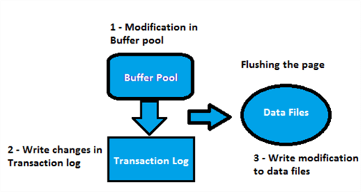
Transaction Log Workflow

Slide 29

Locking
To prevent problems in the pessimistic concurrency model, every DBMS must have mechanisms that control the access of data by all users at the same time.
Locking has several different aspects:
  Lock duration
  Lock modes
  Lock granularity
Notes:
Concurrency can lead to several negative effects, such as the reading of nonexistent data or loss of modified data. Consider this real-world
example illustrating one of these.
Dirty reads:
Lock duration ( how long to hold the lock for, depends on isolation levels)
Lock modes ( what type of lock is being set exclusive, shared)
Lock granularity ( on a row, a page, a table, or a db)

Slide 30
Lock modes for row- and page-level locking
Shared - reserves resources for reading only
Exclusive - reserves resources for the exclusive use of a single transaction
Update - An update lock can be placed only if no other update or exclusive lock exists. It can be placed on objects that already have shared locks.
Notes:
Shared - reserves resources for reading only. Other processes cannot modify it. Several processes can read the resource locked with
the shared lock.
Exclusive -> It is used for DML statements (INSERT, UPDATE, and DELETE) that modify the resource
Update. After Shared locks are gone, it is upgraded to exclusive

Slide 31
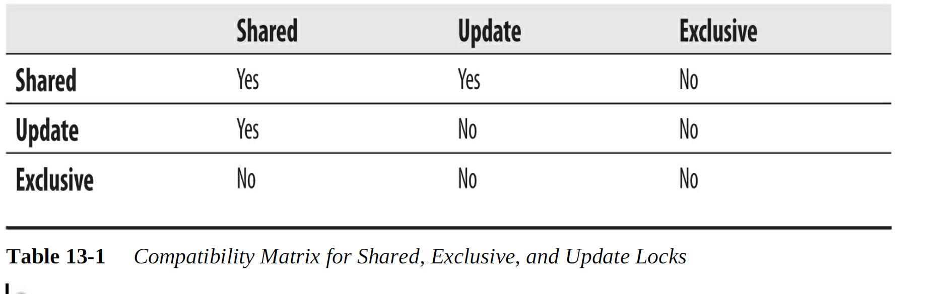
Compatibly Matrix for Locks
Notes:
If you have a user that puts a shared lock, can you add another,

Slide 32
Lock Granularity
Row
Page
Index key or range of index keys
Table
Extent
Database itself
Notes:
Index key or range of index keys – for a clustered table, with cluster index the data pages are stored at the leaf level of the
(clustered) index structure and are therefore locked with index key locks
instead of row locks.
Locking is also done on disk units, called extents, that are 64K in size
(see

Slide 33
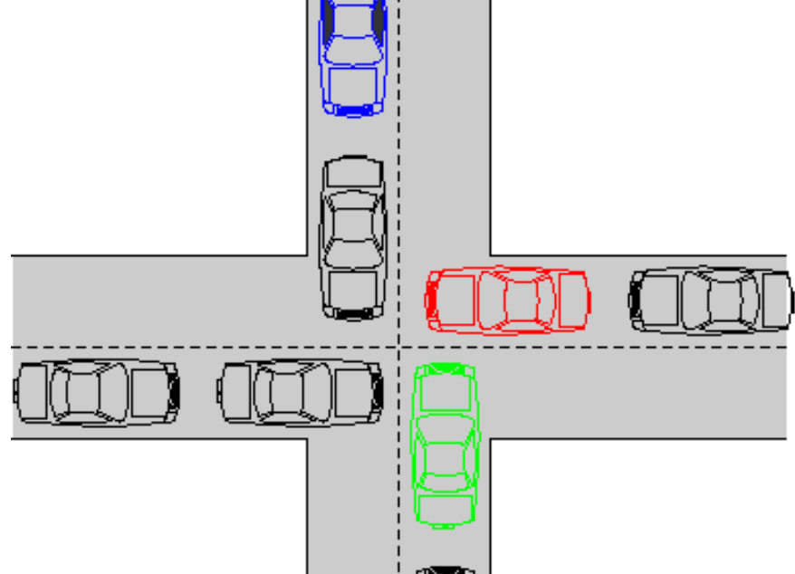
Deadlock
two transactions block the progress of each other
The first transaction has a lock on some database object that the other transaction wants to access, and vice versa.
Notes:
Special locking scenarios

Slide 34
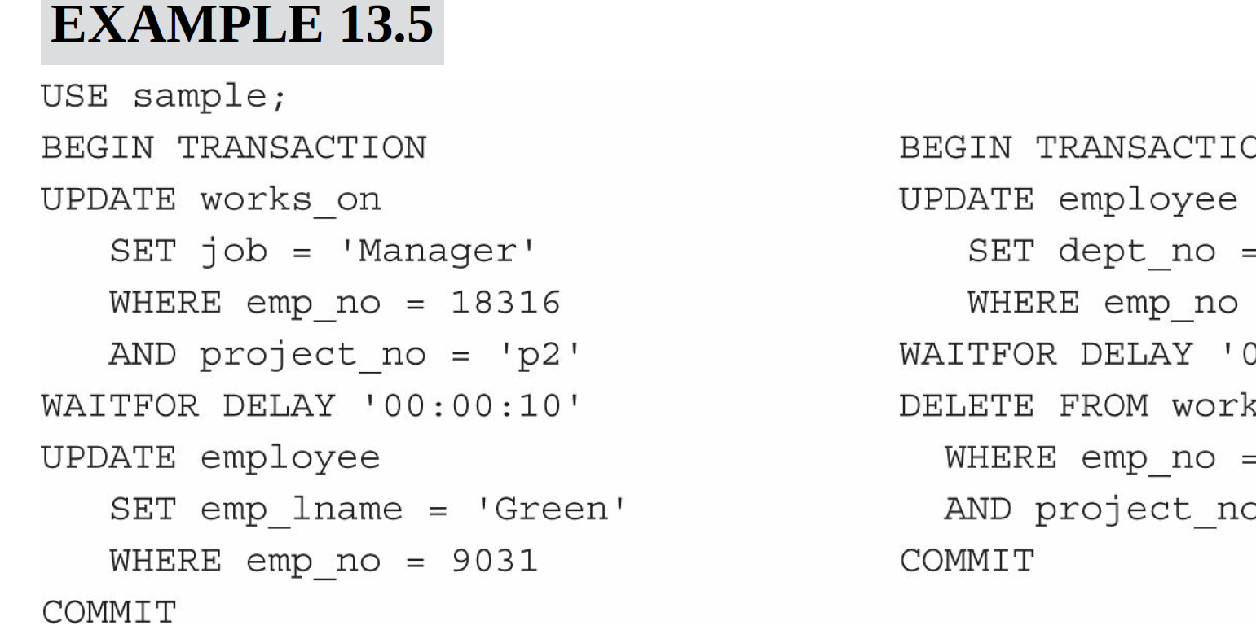

Slide 35
Isolation Levels
Pessimistic model
READ UNCOMMITTED
REPEATABLE READ
SERIALIZABLE
Optimistic model
SNAPSHOT
Both models
READ COMMITTED
Notes:
Using isolation levels, you can specify which of the concurrency problems discussed in the preceding section may occur and which you want to avoid.

Slide 36
READ UNCOMMITTED
does not isolate the read operations from other transactions at all.
it acquires no locks and respects none of the existing locks
The data is read may be inconsistent. If the latter transaction rolls back later, the former transaction reads data that never really existed.
The weakest ISOLATION LEVEL
Notes:
the four concurrency problems described in the preceding section,
READ UNCOMMITTED allows dirty reads, nonrepeatable reads, and
phantoms.

Slide 37
READ UNCOMMITTED Example
BEGIN TRAN A
BEGIN TRAN B
BEGIN TRAN
A =10
Read(A)
Read(A)
A =10
Run operation 1
SET A = A + 1
SET A = A + 1
Run operation 2
Write(A)
A =11
Read(A)
A =11
Write(A)
ROLLBACK
END TRAN A
BEGIN TRAN
Read record that hasn’t been committed yet. No isolation of the two transactions
Notes:
No isolation from read and write

Slide 38
READ COMMITTED
tests only whether an exclusive lock is placed on the row. If no such lock exists, the transaction fetches the row.
This is done using a shared lock. After reading the data values, the data can be changed by some other transaction.
prevents the transaction from reading data that is not committed
concurrent data is improved, but non-repeatable reads and phantoms can still happen.
Notes:
This action prevents the transaction from reading data that is not committed and that can be subsequently rolled back.
access to the concurrent data is improved, but nonrepeatable reads and phantoms can still happen.
The READ COMMITTED isolation level is the default isolation level for SQL Server Database Engine

Slide 39
READ COMMITTED Example
time
BEGIN TRAN A
A =10
BEGIN TRAN
BEGIN TRAN B
Place S
Release S
Read(A)
A =10
Read(A)
Read (A)
A =10
SET A = A + 1
SET A = A + 1
Run operation 2
Place X
A =11
Write(A)
Read(A)
Wait X exist
ROLLBACK
Release X
END TRAN A
A =10
Write(A)
Fixes the problem with lost update and dirty reads
BEGIN TRAN

Slide 40
REPEATABLE READ
places shared locks on all data that is read and holds these locks until the transaction is committed or rolled back.
The disadvantage of this isolation level is that concurrency is further reduced, because the time interval during which other transactions cannot update the same data is significantly longer than in the case of READ COMMITTED.
does not prevent another transaction from inserting new rows, which are included in subsequent reads, so phantoms can appear.

Slide 41
REPEATABLE READ Example
time
BEGIN TRAN A
BEGIN TRAN
BEGIN TRAN B
A =10
Read(A)
Place S
Read(A)
Read (A)
A =10
Update A =11
Wait, Place U lock
Read(A)
A =10
ROLLBACK
Release S
END TRAN A
-----------------------------------------------------------------------------------------------------------------------------
Convert U to X
BEGIN TRAN
holds these locks until the transaction is committed or rolled back
It prevents the row from being updated, but doesn’t prevent new records to be inserted

Slide 42
SERIALIZABLE
acquires a range lock on all data that is read by the corresponding transaction
also prevents the insertion of new rows by another transaction until the former transaction is committed or rolled back
SERIALIZABLE is the strongest isolation level
Notes:
The SERIALIZABLE isolation level is implemented using a key-range
locking method. This method locks individual rows and the ranges
between them.

Slide 43
SERIALIZABLE Example
time
BEGIN TRAN A
BEGIN TRAN
BEGIN TRAN B
A =10
Read(A)
Place S
Read(A)
Read (A)
A =10
INSERT New Row
Wait, Place U lock
Read(A)
A =10
ROLLBACK
Release S
END TRAN A
-----------------------------------------------------------------------------------------------------------------------------
Convert U to X
BEGIN TRAN
range lock on all data that is read by the corresponding transaction
prevents the insertion of new rows by another transaction

Slide 44
Setting and Editing Isolation Levels
The TRANSACTION ISOLATION LEVEL clause of the SET statement
Isolation-level hints
  READUNCOMMITTED
  READCOMMITTED
  REPEATABLEREAD
  SERIALIZABLE
Example:
SET TRANSACTION ISOLATION LEVEL REPEATABLE READ;

